Slide 1
Introduction To Microservices
Bhawna Gunwani
Corporate Trainer and Consultant

Slide 2
Monolithic Architecture

Slide 3
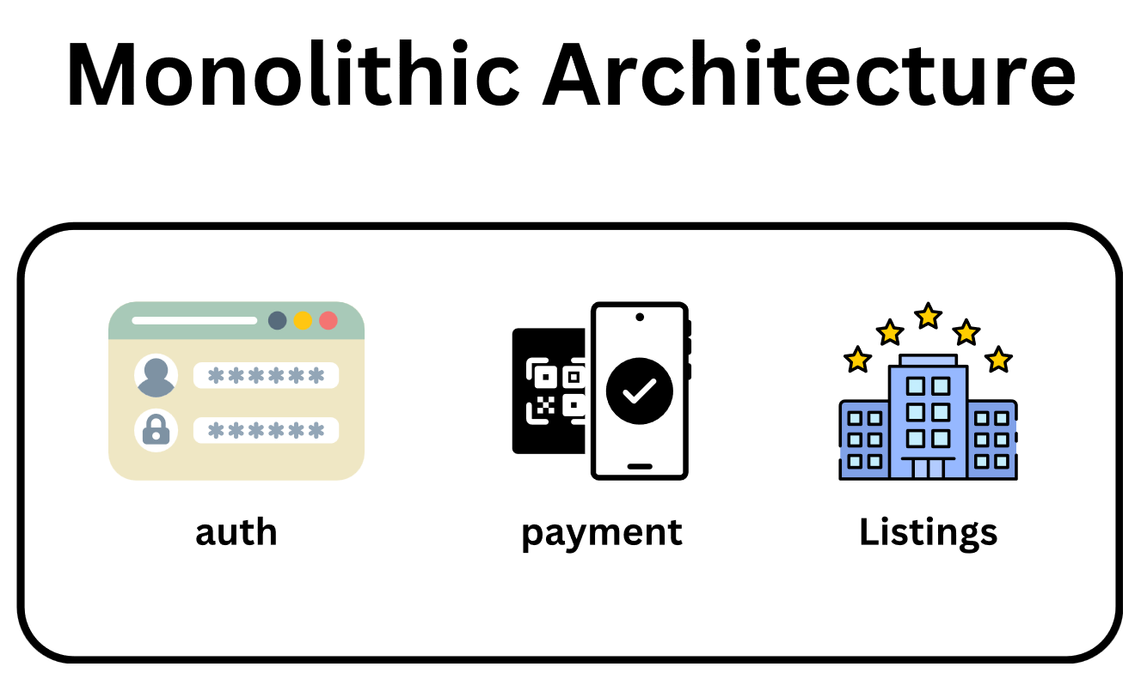

Slide 4
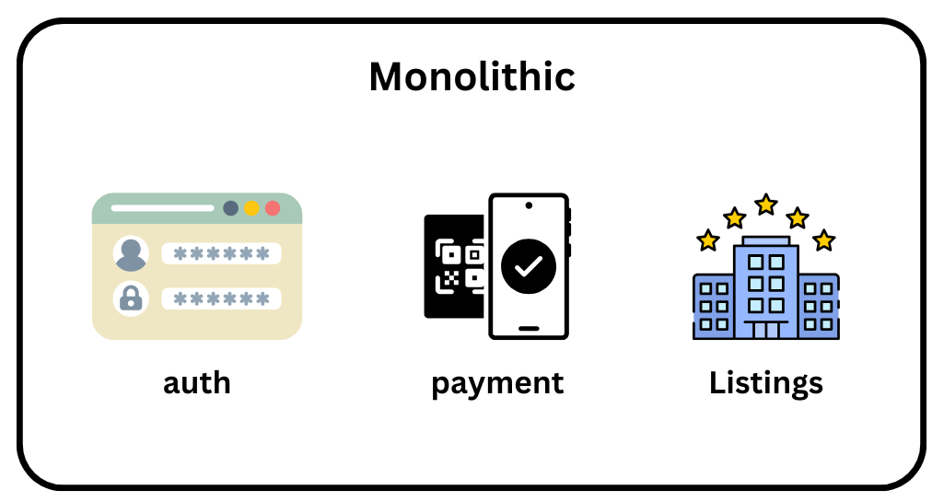
Principles
Develop
Deploy

Slide 5
Benefits of Monolithic Architecture
Easier to Manage
Easier to Develop

Slide 6
Issues with Monolithic Architecture
Redeployment
Scaling Limitations
Lots of Dependence

Slide 7
MicroServices Architecture

Slide 8
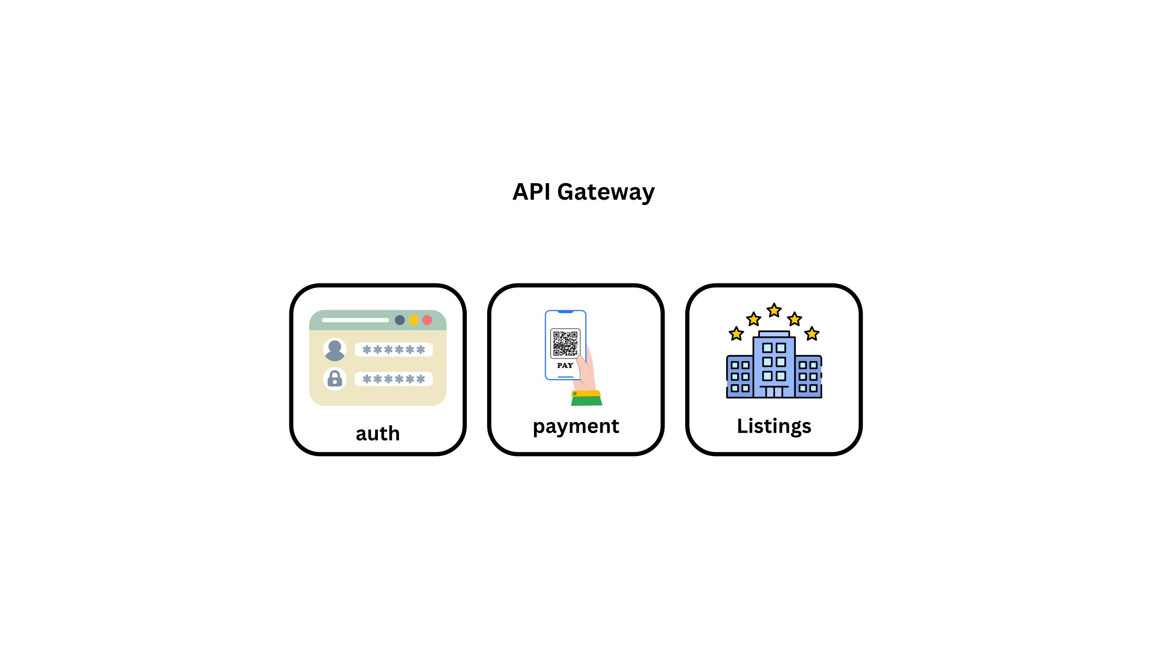

Slide 9
Benefits
Independent Development
Separate Codebase
Independent Deployment

Slide 10
Difference b/w Monolithic and Microservices Architecture

Slide 11
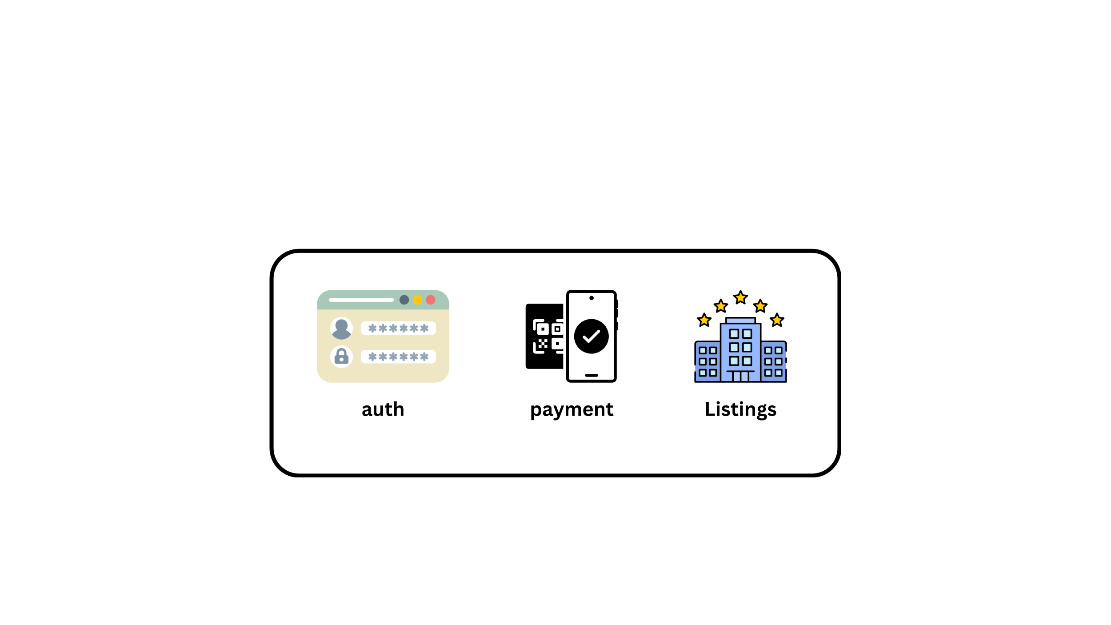

Slide 12
Synchronous Communication

Slide 13
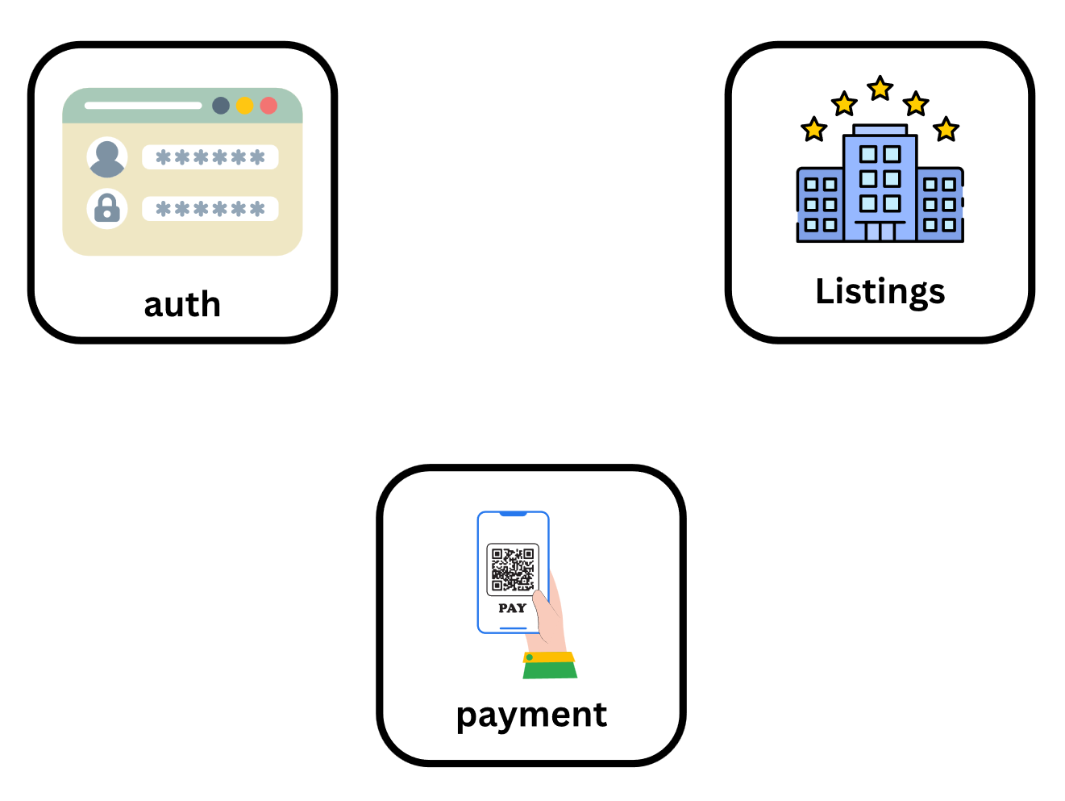
Synchronous Communication
http request
http Response
http Response
http Response
http request
http request

Slide 14
Asynchronous Communication

Slide 15
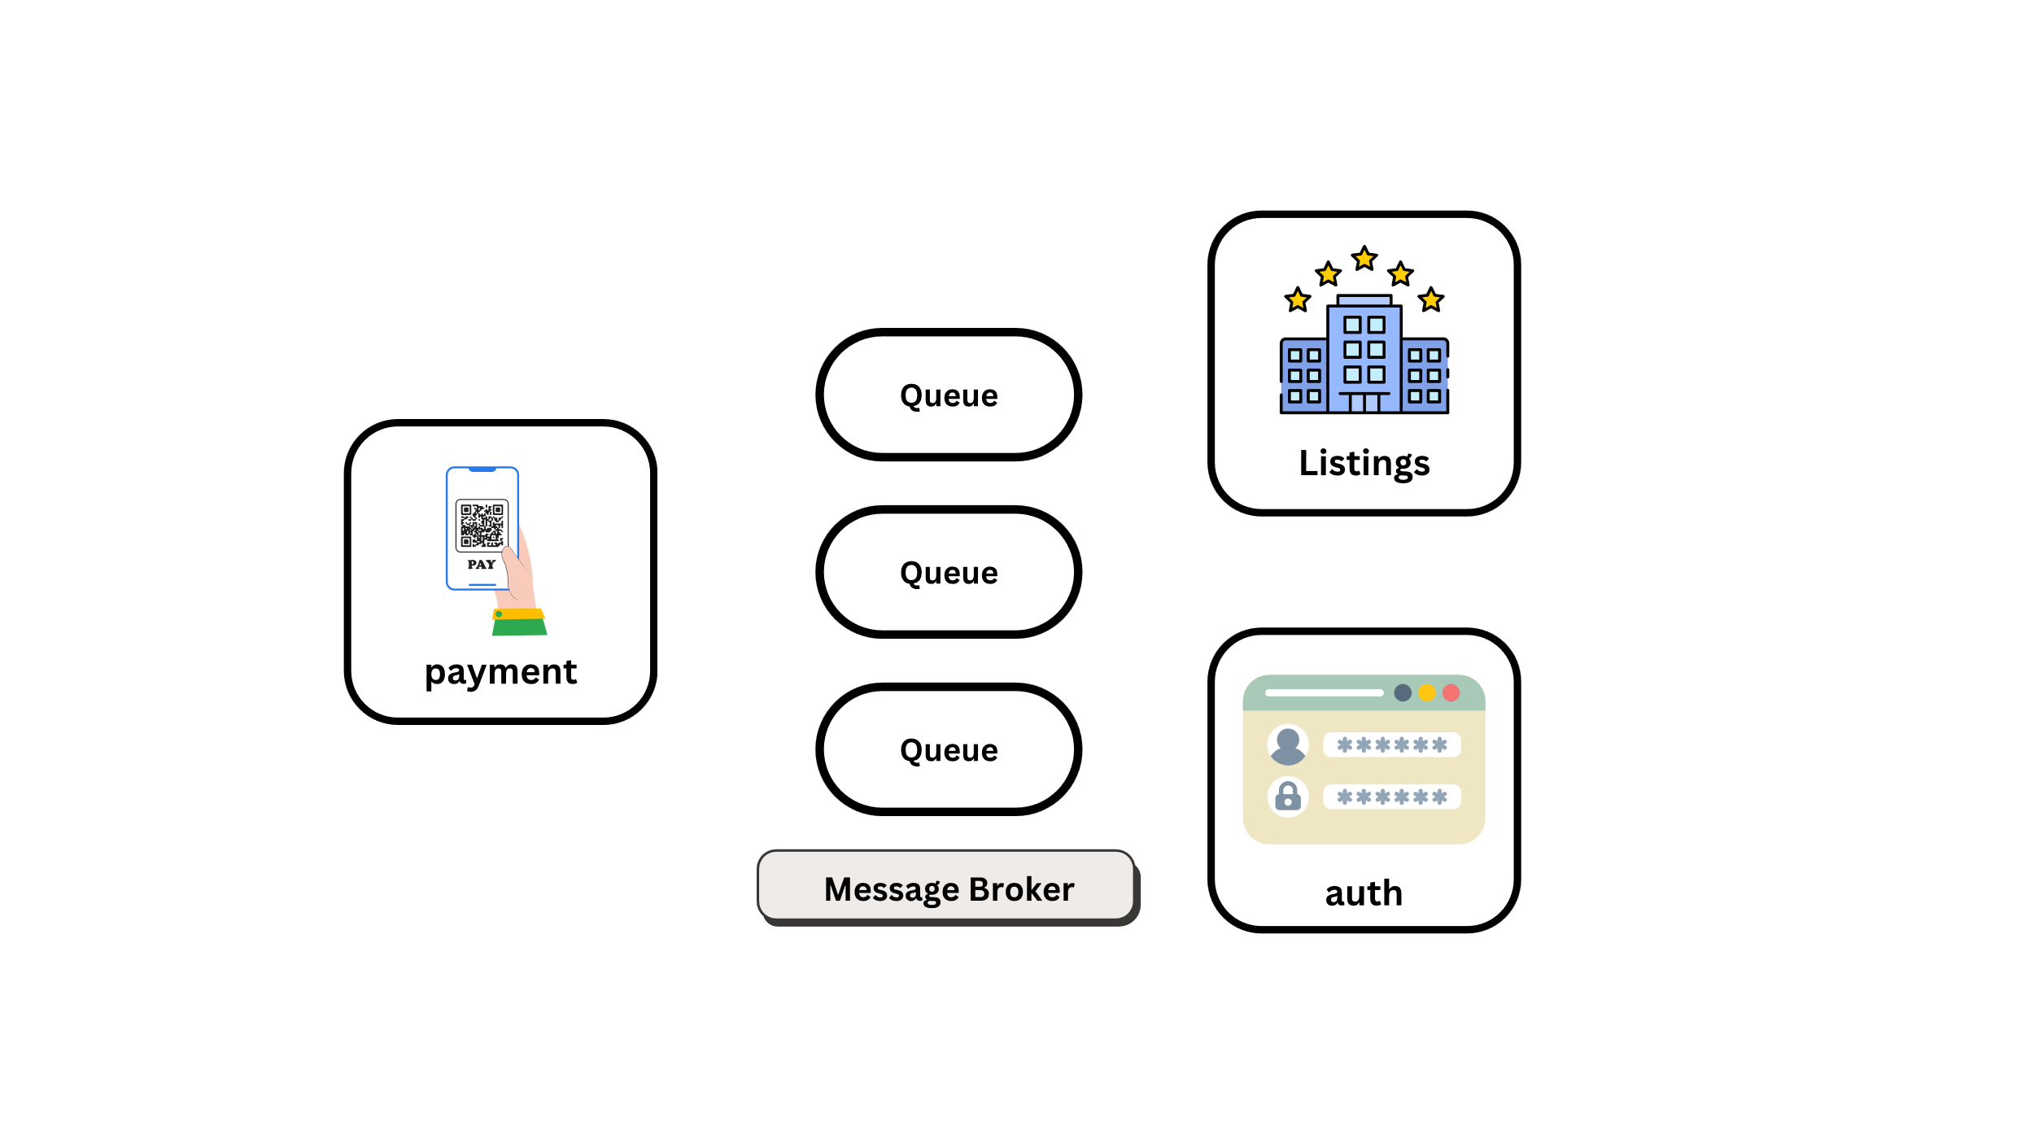
Asynchronous Communication

Slide 16
Disadvantages
Complex
Management Overhead
High Infra Cost

Slide 18
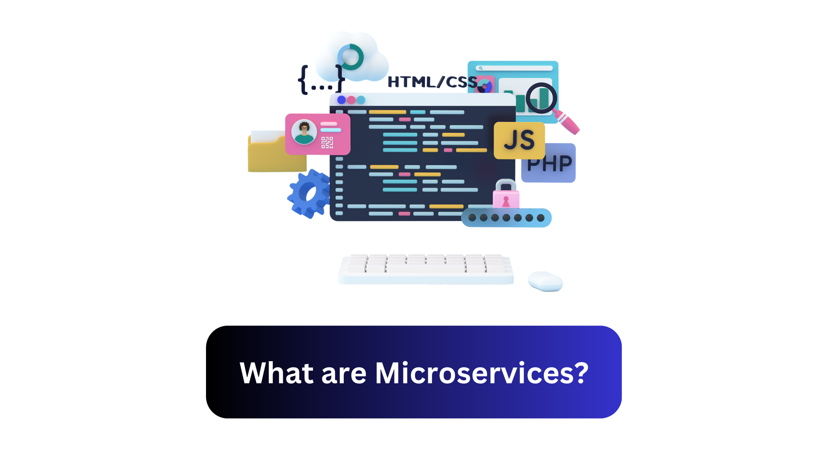

Slide 19
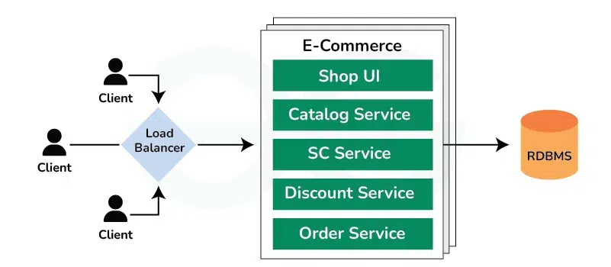
Monolithic Architecture Before Microservices
Monolithic Architecture is like a big container wherein all the software components of an application are assembled and tightly packaged.

Slide 20
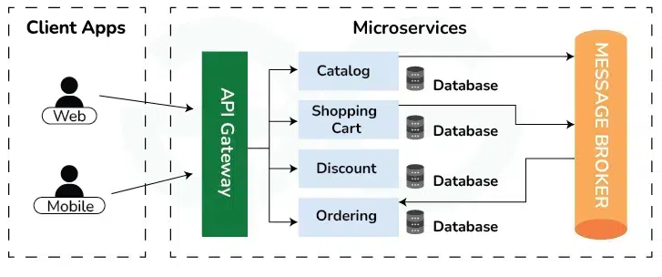
What is Microservices Architecture?
Microservices Architecture is an architectural style that structures an application as a collection of small autonomous services, modelled around a Business Domain.

Slide 21
Features of Microservices
Small Focused
Loosely Coupled
Language Neutral
Bounded Context

Slide 22








Companies using Microservices

Slide 23
Top reasons to learn Microservices

Slide 24
Top Reasons to learn Microservices
Easy to Build and Maintain
Continuous Delivery
Hybrid Technologies
Cross Team Coordination
Higher Quality Code
Smarter Scaling
Risk Reduction
Promote Big Data Best Practices

Slide 25
Introduction to Spring Boot

Slide 26
What is Spring Boot?
Spring Boot is a project that is built on the top of the Spring Framework. It provides an easier and faster way to set up, configure, and run both simple and web-based applications. It is a Spring module that provides the RAD (Rapid Application Development) feature to the Spring Framework. It is used to create a stand-alone Spring-based application that you can just run because it needs minimal Spring configuration.

Slide 27
Why should we Use Spring Boot?
The dependency injection approach is used in Spring Boot.
It contains powerful database transaction management capabilities.
It simplifies integration with other Java frameworks like JPA/Hibernate, Struts, etc.
It reduces the cost and development time of the application.

Slide 28
Advantages of Spring Boot
Used to build standalone applications.
01
No need to deploy WAR files.
02
Doesn’t require XML configuration.
03
Embeds Tomcat, Jetty and Undertow directly.
04
Offers production ready features.
05
Easier management and customization.
06

Slide 29
Goals of Spring Boot
Provides Opinionated Development approach
Avoids defining more Annotation Configuration
Avoids writing lots of import statements
Avoids XML Configuration.

Slide 30
Prerequisites
Java Programming Knowledge
Spring Framework Basics
Maven/Gradle
Web Development Basics
Basic knowledge of Git for version control
Spring Boot 3.4.0, launched on November 21, 2024, is Latest Spring Boot Version.

Slide 31
Spring Boot Features
Web Development
SpringApplication
Application events and listeners
Admin features
Externalized Configuration
Logging

Slide 32
Spring Boot Architecture

Slide 33
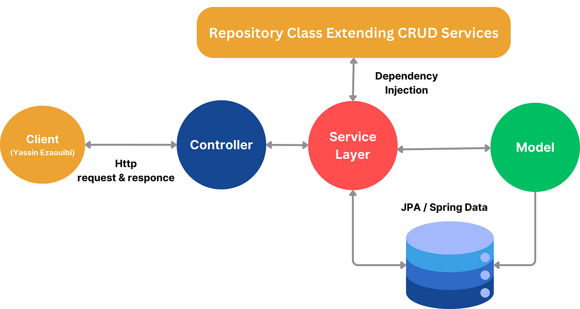
Spring Boot Architecture

Slide 34
Create Projects Using Spring Boot

Slide 35

Spring Initializr
Using Spring Initializr:
Visit the Spring Initializr website.
Choose the project type, language, and Spring Boot version.
Add dependencies as per your project requirements.
Click "Generate" to download the project as a ‘.zip’ file.
Extract the file and open it in your favorite IDE.

Slide 36

IntelliJ IDEA
Using IntelliJ IDEA:
Open IntelliJ IDEA and create a new project.
Select Spring Initializr under the New Project menu.
Configure the project metadata and add required dependencies.
IntelliJ will set up the project and download the necessary dependencies.

Slide 37

Eclipse with Spring Tools Suite
Using Eclipse with Spring Tools Suite (STS):
Install the Spring Tools Suite plugin in Eclipse.
Go to File > New > Spring Starter Project.
Fill in the project metadata (group ID, artifact ID, etc.) and add dependencies.
Eclipse will create and configure the Spring Boot project.

Slide 38
Spring Boot Annotations

Slide 39
Spring Boot Annotations
Spring Boot is a project that is built on the top of the Spring Framework. It provides an easier and faster way to set up, configure, and run both simple and web-based applications. It is a Spring module that provides the RAD (Rapid Application Development) feature to the Spring Framework. It is used to create a stand-alone Spring-based application that you can just run because it needs minimal Spring configuration.
Note: For more details, please visit the given link Spring Boot Annotations

Slide 40
Spring Boot Application Properties

Slide 41
Spring Boot Application Properties
Spring Boot provides various properties that can be configured in the application.properties file. The properties have default values. We can set a property(s) for the Spring Boot application. Spring Boot also allows us to define our own property if required.

Slide 42
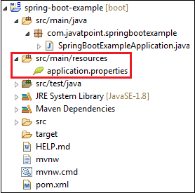
Spring Boot Application Properties
Spring Boot 3.4.0, launched on NSpring Boot Framework comes with a built-in mechanism for application configuration using a file called application.properties. It is located inside the src/main/resources folder, as shown in the following figure.

Slide 43
Spring Boot Property Categories
Core Properties
Cache Properties
Mail Properties
JSON Properties
Transaction Properties
Data Migration Properties
Integration Properties
Web Properties
Data Properties
Templating Properties
Server Properties
Security Properties
RSocket Properties
Actuator Properties
DevTools Properties
Testing Properties

Slide 44
Spring Data JPA

Slide 45
Spring Data JPA
Spring Data JPA is a part of the larger Spring Data project that simplifies the process of implementing data access layers in applications that use JPA (Java Persistence API). JPA is a standard specification for ORM (Object-Relational Mapping) in Java, and Spring Data JPA acts as a bridge between Spring applications and JPA.

Slide 46
Spring Data JPA Features
No-code repository simplifies persistence by enabling business logic implementation at a higher abstraction level.
Reduced boilerplate: Repository interfaces auto-implement read/write methods.
Generated Queries: Spring auto-creates queries from method names starting with findBy.

Slide 47
Spring Data Repositories

Slide 48
Crud Repository
CrudRepository: It offers standard create, read, update, and delete It contains method like findOne(), findAll(), save(), delete(), etc.
import org.springframework.data.repository.CrudRepository;
public interface UserRepository extends CrudRepository<User, Long> {
// No need to define methods for basic CRUD operations
// e.g., save(), deleteById(), findById() are available by default
}

Slide 49
JPA Repository
JpaRepository: It is a JPA specific repository It is defined in Spring Data Jpa. It extends the both repository CrudRepository and PagingAndSortingRepository. It adds the JPA-specific methods, like flush() to trigger a flush on the persistence context.
import org.springframework.data.jpa.repository.JpaRepository;
public interface UserRepository extends JpaRepository<User, Long> {
// No need to define methods for basic CRUD operations
// Additional JPA-specific methods like flush() and saveAll() are available by default
}

Slide 50
PagingAndSorting Repository
PagingAndSortingRepository: It extends the CrudRepository and adds the findAll methods. It allows us to sort and retrieve the data in a paginated way.
import org.springframework.data.repository.PagingAndSortingRepository;
public interface UserRepository extends PagingAndSortingRepository<User, Long> {
// Provides pagination and sorting functionality
Page<User> findByName(String name, Pageable pageable);
// Custom method with pagination
}

Slide 51
Hibernate vs JPA
Feature | JPA | Hibernate
Type | Specification (API) | ORM Framework
Role | Defines how ORM should work | Provides the actual implementation of ORM
Database Independence | Aims to be database-independent | Hibernate supports multiple databases
Custom Features | Only defines basic ORM functionality | Includes advanced features like caching, lazy loading, and automatic dirty checking
API | Uses standard JPA interfaces (EntityManager, Query, etc.) | Includes custom Hibernate API (Session, SessionFactory) in addition to JPA

Slide 52
Spring Boot Starter Actuator

Slide 53
Spring Boot Application Properties
Spring Boot Actuator is a sub-project of the Spring Boot Framework. It includes a number of additional features that help us to monitor and manage the Spring Boot application. It contains the actuator endpoints. We can use HTTP and JMX endpoints to manage and monitor the Spring Boot application. If we want to get production-ready features in an application, we should use the Spring Boot actuator.

Slide 54
Actuator Features
Endpoint: The actuator endpoints allows us to monitor and interact with the application. Spring Boot provides a number of built-in endpoints. We can also create our own endpoint. We can enable and disable each endpoint individually.
Metrics: Spring Boot Actuator provides dimensional metrics by integrating with the micrometer. The micrometer is integrated into Spring Boot. It is the instrumentation library powering the delivery of application metrics from Spring.
Audit: Spring Boot provides a flexible audit framework that publishes events to an AuditEventRepository. It automatically publishes the authentication events if spring-security is in execution.

Slide 55
Spring Boot Packaging

Slide 56
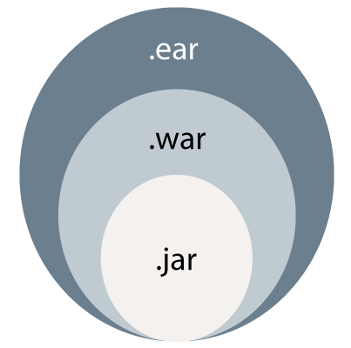
Spring Boot Packaging
In the J2EE application, modules are packed as JAR, WAR, and EAR. It is the compressed file formats that is used in the J2EE. J2EE defines three types of archives:

Slide 57
WAR
WAR stands for Web Archive. WAR file represents the web application.
Web module contains servlet classes, JSP files, HTML files, JavaScripts, etc.
It contains a special directory called WEB-INF.
WAR is a module that loads into a web container of the Java Application Server.
The Java Application Server has two containers: Web Container and EJB Container.

Slide 58




